Slide 1
Driver Drowsiness Detection System
CSE 495
2nd Presentation
Yakup Talha Yolcu
Project Advisor : Yrd. Doç. Dr. Burcu Yılmaz
October 2022

Slide 2
Content
Project Definition
What is done so far?
What will I do from now on?
Resources and References

Slide 3
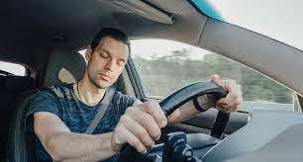

Project Definition
In this project we have a system that gives an alarm if driver is detected as drowsy.
Drowsiness detection works on two different situations :
If driver is closing their eyes for an amount of time
If driver can’t keep their head up for an amount of time (moves the head to any side without turning head)
When driver is detected as drowsy

Slide 4
What is done so far?
24.10-06.11 | 07.11-31.01 | 02.01-15.01
Get ready the hardware (Rasperry pi, camera etc…) Determine datasets to be used | Installing needed libraries to the hardware. Developlment of mobile app Training models and compare models with each other to determine success rates. | Test the system with different drivers. Determine success rate of the project
After first presentation, I get ready rasperry pi and camera module. Then I obtained 2 large datasets and I am creating 1 dataset myself
Large dataset 1 has 4 classes, 2 for eyes (opened – closed) 2 for faces (drowsy – awake) each has more than 600 images.
Large dataset 2 has 4 classes all for eyes as opened and closed and with glasses and without glasses. Each has more than 500 images.
The dataset that I am creating has 40 images with 2 classes drowsy and awake.

Slide 5
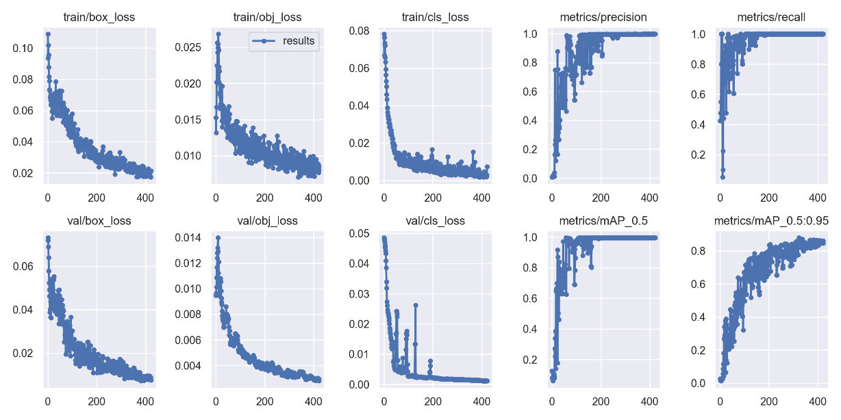
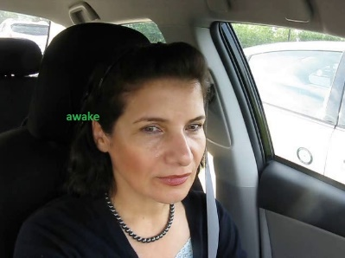
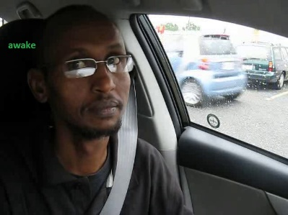

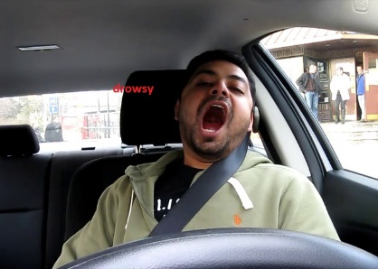
What is done so far?
I used large dataset 1 and get these results by using YOLOV5s model

Slide 6
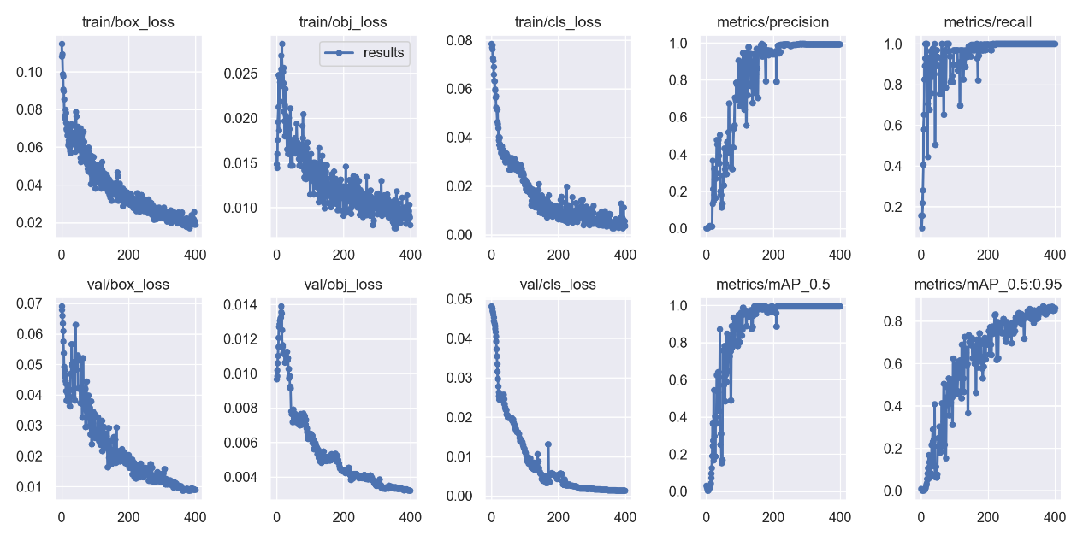
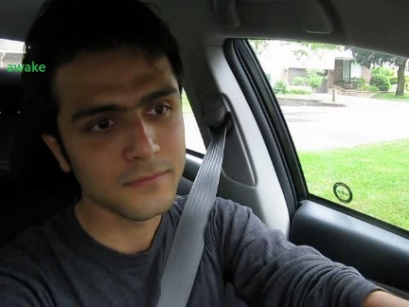
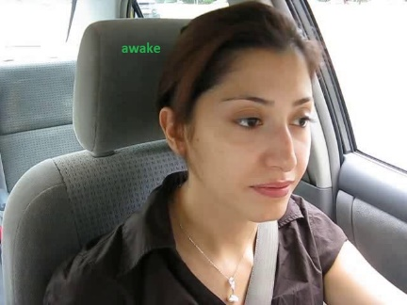
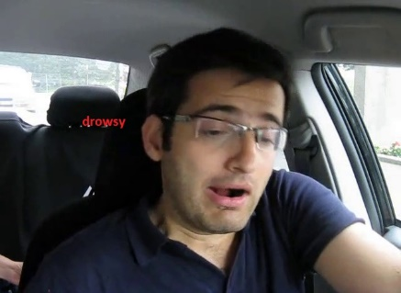
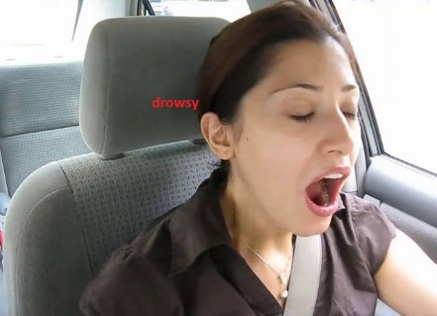
What is done so far?
I used large dataset 1 with combined my own dataset and get these results by using YOLOV5s model

Slide 7
What will I do from now on?
From now on, I continue creating my dataset and I will also test these programs in Rasperry Pi and with its camera module.
I will use one more model with Haar Cascade Face Classification and try to combine it to my main program
After obtaining well working detector, I will set the alarm sound

Slide 8
Resources and References
https://www.nauto.com/blog/introducing-driver-drowsiness-alerts (Drowsy driver in Project Definition page)
https://www.canstockphoto.com/the-view-inside-the-empty-car-the-54421487.html (Empty car inside view used in Project Design Page)
https://dergipark.org.tr/en/download/article-file/19838 (Analysis of Traffic Accidents in Turkey, Islim Sungur, Recep Akdur , Birgül Piyal)
Poursadeghiyan M, Mazloumi A, Nasl Saraji G, Baneshi MM, Khammar A, Ebrahimi MH. Using Image Processing in the Proposed Drowsiness Detection System Design. Iran J Public Health. 2018 Sep;47(9):1371-1378. PMID: 30320012; PMCID: PMC6174048.
Identification of Driver Drowsiness Using Image Processing K.Praveen Kumar, Srinivasa Rao Thamanam, M. Naresh Kumar
Gilbile, P., Bhore, P., Kadam, A., Balbudhe, K. (2019). Driver’s Drowsiness Detection Using Image Processing. In: Pandian, D., Fernando, X., Baig, Z., Shi, F. (eds) Proceedings of the International Conference on ISMAC in Computational Vision and Bio-Engineering 2018 (ISMAC-CVB). ISMAC 2018. Lecture Notes in Computational Vision and Biomechanics, vol 30. Springer, Cham. https://doi.org/10.1007/978-3-030-00665-5_70

